Slide 1
Welcome to kiruthika and harini’s presentation
“Whenever you find yourself on the side of the majority ,it is time to pause and reflect”
-Mark Twain

Slide 2

WIRELESS NETWORK SECURITY ASSESMENT

Slide 3
overview
What is Wireless Networking?
What is Wireless Security?
Threats to Wireless Networks
Parking a Lot Attack
Security in WLAN 802.11
Thoughts on Wireless Security
Conclusion

Slide 4
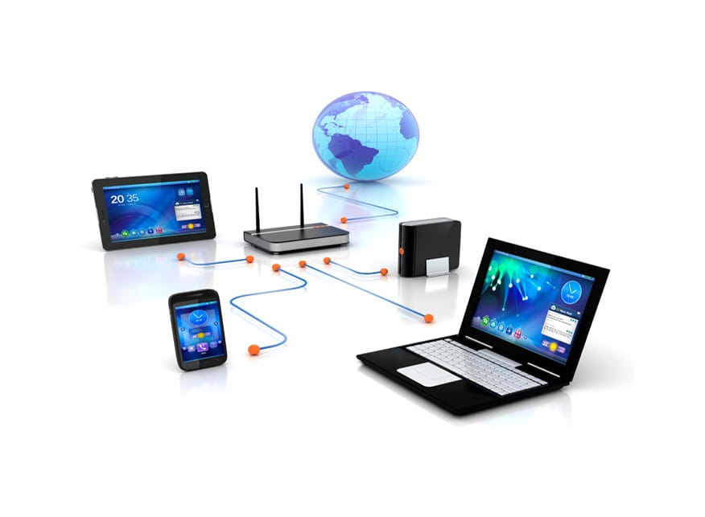
What is wireless networking?
A wireless network is a computer network that uses wireless data connections between network nodes.
It provides the flexibility and freedom that wired networks lack
The main standards in the wireless world are:
802.11,which describes the Wireless LAN architecture.
802.16,which describes the Wireless MAN architecture.

Slide 5

What is wireless security?
Access Point(AP):
Allows wireless communication device,such as computers to connect to a wireless network
Service set Identifier(SSID):
SSID allows wireless clients to communicate with an appropriate access point.Only clients with correct SSID can communicate with the AP.

Slide 6

THREAT TO WIRELESS NETWORKS

Slide 7
Following are the threats to Wireless Networks:
Malicious Association:
A wireless device is configured to appear to be a legitimate access point,and then the operator penetrates the wired network through a legitimate wireless access point
Ad hoc Network:
These are peer-to-peer networks between wireless computers with no access point between them.Such networks can pose a security threat due to a lack of a central point of control.
Identify theft(MAC Spoofing):
This occurs when an attacker is able to evesdrop on network traffic and identify the MAC address of a computer with network privileges.

Slide 8
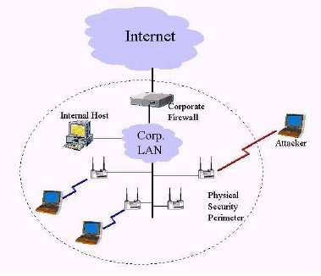
PARKING LOT ATTACK
Wireless Signals are intercepted outside an organization,or even though the floors in multi-storey buildings.
“Parking lot” signifies that the attacker sit in the organization’s parking lot and try to access internal hosts via the wireless network.

Slide 9
SECURITY IN WLAN 802.11
802.11 Standard
802.11 Authentication
Wired Equivalent Privacy(WEP)
WEP Weakness

Slide 10
802.11 standard
The 802.11 IEEE standard was standardized in 1997
It consists of three layers:Physical layer,MAC(Medium Access Control) layer, and LLC(Logical Link Control) layer
The first version of the standard supported only 2 Mbps bandwidth,which motivated the developing teams to come up with other standards to support upto 54Mbps.

Slide 11
802.11 authentication
Two types of authentication used:
Open System Authentication,
Shared Key Authentication
Open System Authentication:
Default authentication protocol for the 802.11 standard.
Consists of a simple authentication request containing the station ID and an authentication response containing success or failure data.
Upon successful authentication,both stations are considered mutually authenticated.

Slide 12
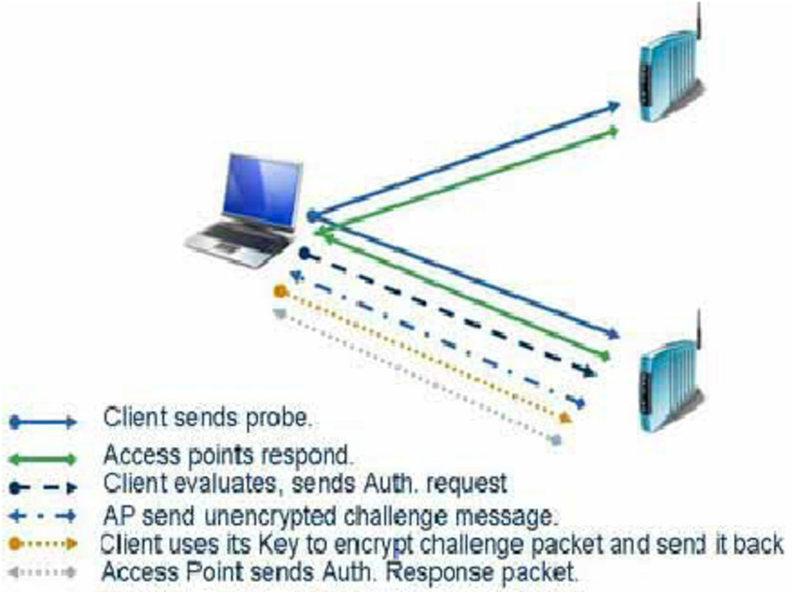
SHARED KEY AUTHENTICATION
Shared key authentication can easily be exploited through a passive attack by eavesdropping.
WEP uses RC4 stream cipher as its encryption algorithm
In the WEP(Wireless Equivalent Privacy) standard both of the authentication modes were supported.In the new security standards,it is not recommended to use shared key authentication.

Slide 13
Wired equivalent privacy
It has 2 goals to achieve for Wireless LAN :
confidentiality and integrity.
It uses Encryption to provide confidentiality.
It uses CRC(Cyclic Redundancy Check) to provide
integrity.

Slide 14
Wep weakness
One of the major reasons behind WEP weaknesses is its key length.
WEP has a 40-bit key,which can be broken in less than five hours using parallel attacks with the help of normal computer machine(Brown2003).
WEP does not support mutual authentication.
CRC(for integrity) lacks the cryptography feature.

Slide 15
Thoughts on wireless security
We can group wireless security measures into those dealing with:
Wireless Transmission(threats involoves eavesdropping,altering or inserting messages,and disruption)
2. Wireless Networks

Slide 16
SECURING WIRELESS TRANSMISSION
Signal-Hiding technique:
#Involves turning off service set identifier(SSID) broadcasting by wireless access points
#Assigning cryptic names to SSIDs
#Reducimg signal strength to the lower level
ENCRYPTION:
#Encryption of all wireless transmission is effective against
eavesdropping to the extent that the encryption keys are secured

Slide 17
SECURING WIRELESS NETWORK
Following techniques can be adopted to secure wireless networks:
Use encryption.Wireless routers are typically equipped with built-in encryption mechanisms for router-to-router traffic.
b) Use antivirus and antispyware software,and a firewall.
c) Turn off identifier broadcasting.
d) Allow only specific computers to access your wireless network

Slide 18
Thankyou for your attention

